Slide 1
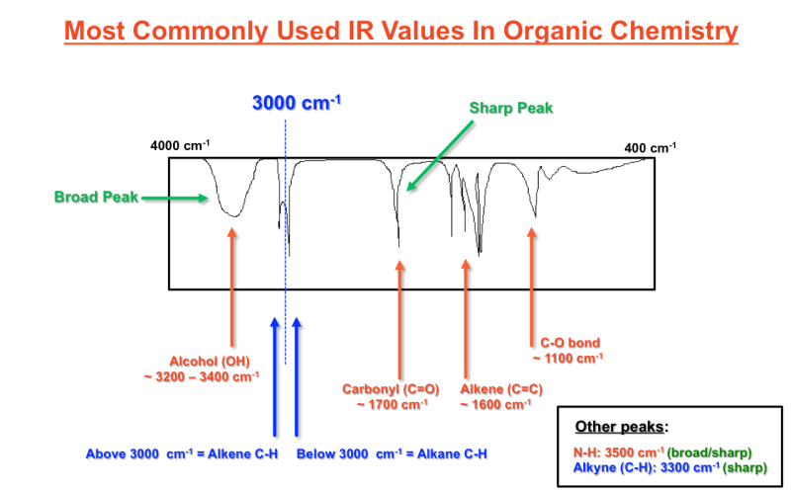
Recap: How molecules vibrate (AKA “normal modes of vibration”)
Stretching
Stretching and bending
Symmetric stretch, bend, and asymmetric stretch. (There’s another bending mode where the atoms move in and out of the plane of the screen here.)

Slide 2

Recap: How molecules vibrate (AKA “normal modes of vibration”)
Stretching
Stretching and bending
How do we take account of vibrational contributions to $U(T,V)$?
Symmetric stretch, bend, and asymmetric stretch. (There’s another bending mode where the atoms move in and out of the plane of the screen here.)

Slide 3

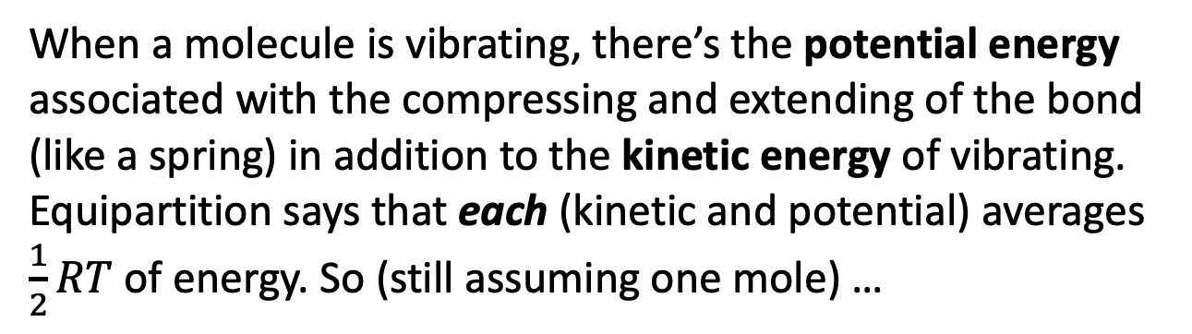
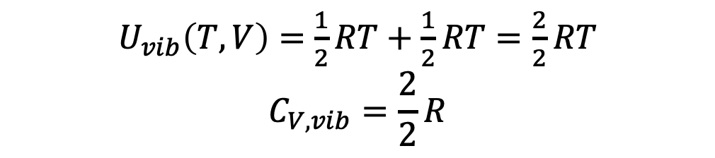
Recap: The vibrational contribution to $U(T,V)$
When a molecule is vibrating, there’s the potential energy associated with the compressing and extending of the bond (like a spring) in addition to the kinetic energy of vibrating. Equipartition says that each (kinetic and potential) averages $\frac{1}{2}RT$ of energy. So (still assuming one mole) …
$U_{vib}\left(T,V\right)=$ $\frac{1}{2}RT+\frac{1}{2}RT=\frac{2}{2}RT$
$$C_{V,vib}=\frac{2}{2}R$$
When a molecule is vibrating
When a molecule can’t vibrate, there’s no contribution to to $U$ or $C_{V}$:
$U_{vib}\left(T,V\right)=$ $0$
$$C_{V,vib}=0$$
When a molecule isn’t vibrating

Slide 4

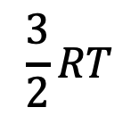


Recap: Why would a molecule vibrate, or not vibrate? Quantum energy discretization
Energy
$$\frac{3}{2}RT$$
$$I_{2}$$
$$F_{2}$$
$$H_{2}$$
At low temperature, only $I_{2}$ can vibrate. $F_{2}$ or $H_{2}$ can’t.

Slide 5
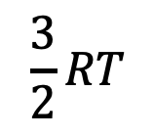
Why do molecules vibrate at high temperature, but not at low temperature?
Energy
$$\frac{3}{2}RT$$
$$I_{2}$$
$$F_{2}$$
$$H_{2}$$
Warmer, so $I_{2}$ and $F_{2}$ can vibrate, but $H_{2}$ can’t.

Slide 6
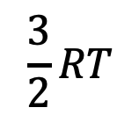
Why do molecules vibrate at high temperature, but not at low temperature?
Energy
$$\frac{3}{2}RT$$
$$I_{2}$$
$$F_{2}$$
$$H_{2}$$
Even hotter, so all three molecules can vibrate.

Slide 7
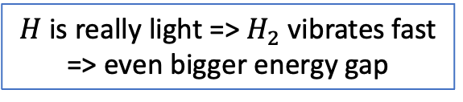
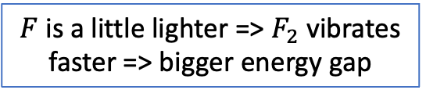
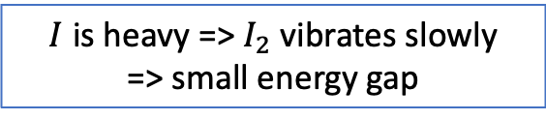
Classical-quantum connection: the energy gap between vibrational levels is proportional to how fast the molecules vibrate
Energy
$$I_{2}$$
$$F_{2}$$
$$H_{2}$$
$I$ is heavy => $I_{2}$ vibrates slowly
=> small energy gap
$F$ is a little lighter => $F_{2}$ vibrates faster => bigger energy gap
$H$ is really light => $H_{2}$ vibrates fast => even bigger energy gap

Slide 8
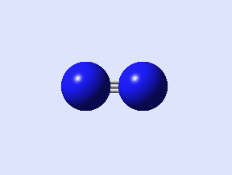
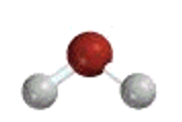


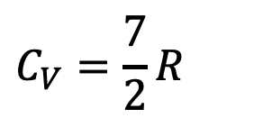


Some low-T (rotating, but not vibrating) regimes, and high-T (vibrating) regimes
$$C_{V}=\frac{5}{2}R$$
$$C_{V}=\frac{7}{2}R$$
Low-temperature regime
High-temperature regime
The high-temperature, vibrating regime is also called the classical regime
$$C_{V}=\frac{12}{2}R$$
High-temperature regime
$$C_{V}=\frac{6}{2}R$$
$$C_{V}=\frac{13}{2}R$$
Low-temperature regime
High-temperature regime

Slide 9
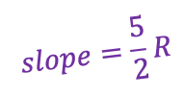

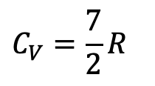




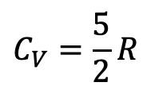
Let $T^{∗}$ define a molecule’s transition from the low-T regime to the high-T vibrational regime
$$U(T,V)$$
$\frac{7}{2}R$
$$slope=\frac{5}{2}R$$
not vibrating
vibrating
$$C_{V}=\frac{5}{2}R$$
$$C_{V}=\frac{7}{2}R$$
$$C_{V}(T,V)$$
$\frac{7}{2}R$
$$\frac{5}{2}R$$
T
T*
High-T (classical) regime
Low-T regime

Slide 10
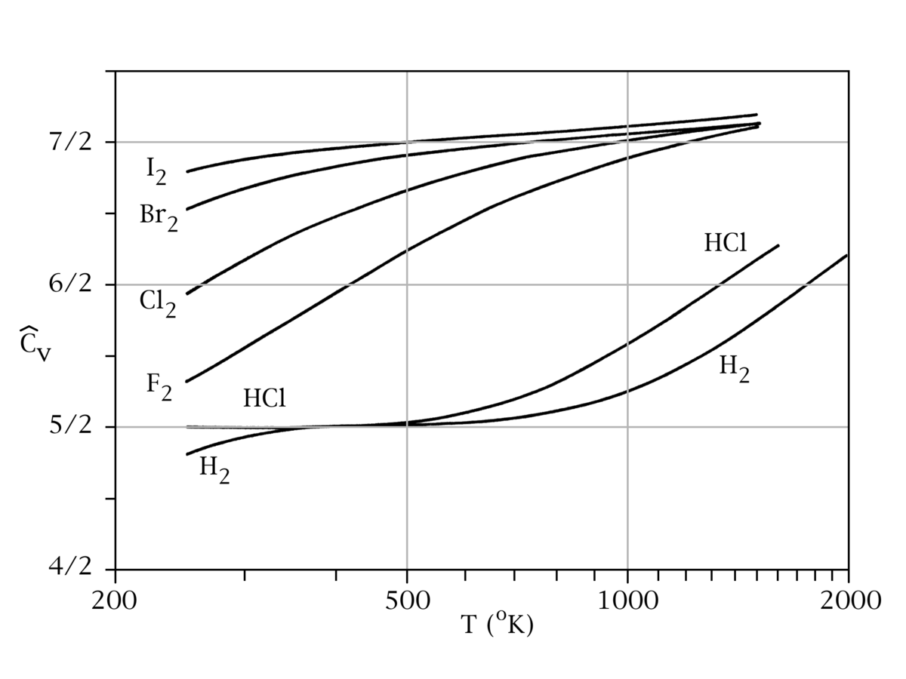

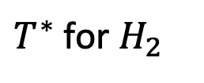
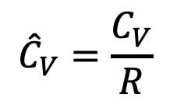
You can see this happening in measured heat capacities – here’s $H_{2}(g)$
Here, ${\hat{C}}_{V}=\frac{C_{V}}{R}$ (one mole).
vibrating
rotating
$${\hat{C}}_{V}=\frac{C_{V}}{R}$$
rotating
$T^{∗}$ for $H_{2}$

Slide 11

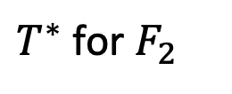
And here’s $F_{2}(g)$
Here, ${\hat{C}}_{V}=\frac{C_{V}}{R}$ (one mole).
$${\hat{C}}_{V}=\frac{C_{V}}{R}$$
$T^{∗}$ for $F_{2}$

Slide 12
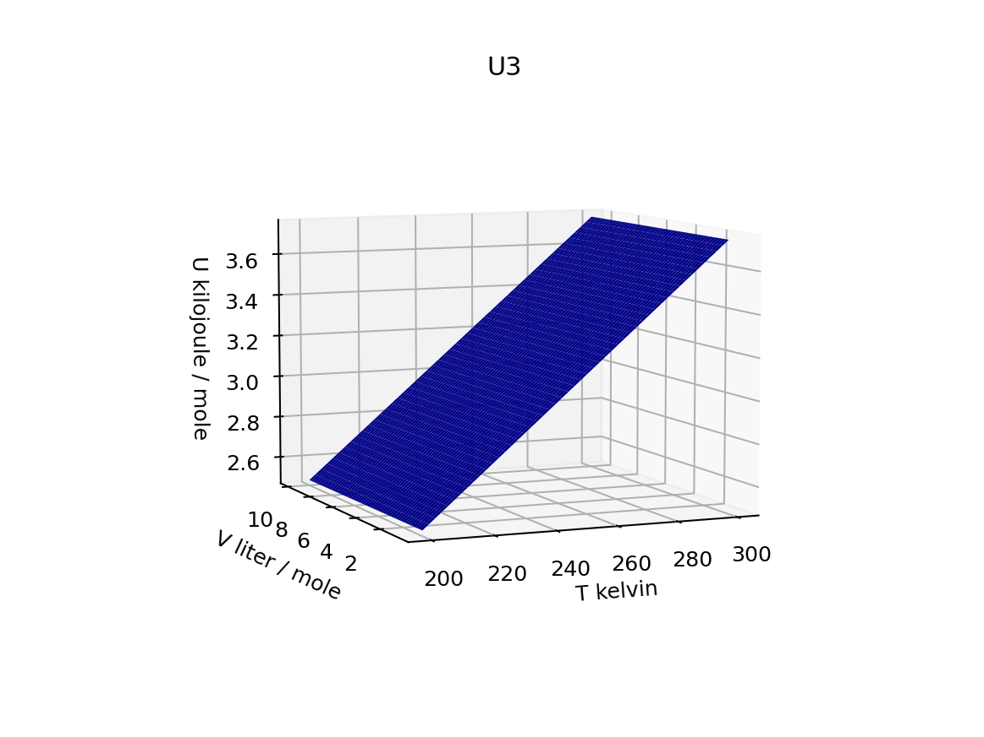
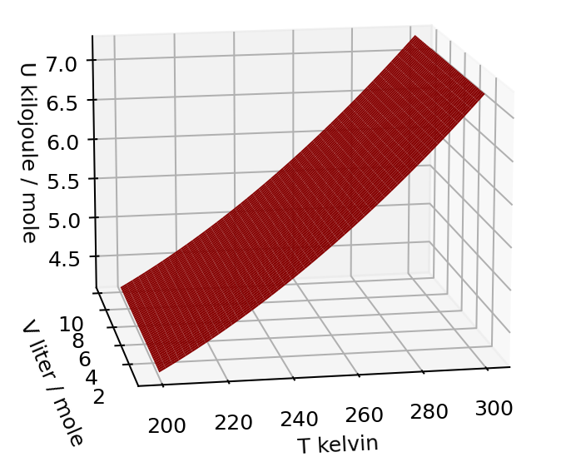
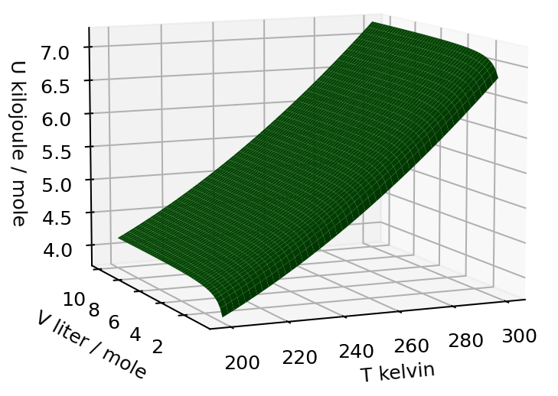
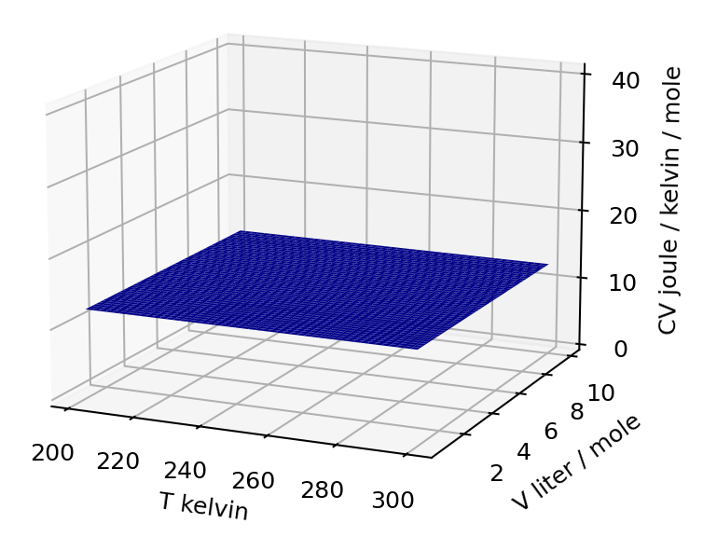
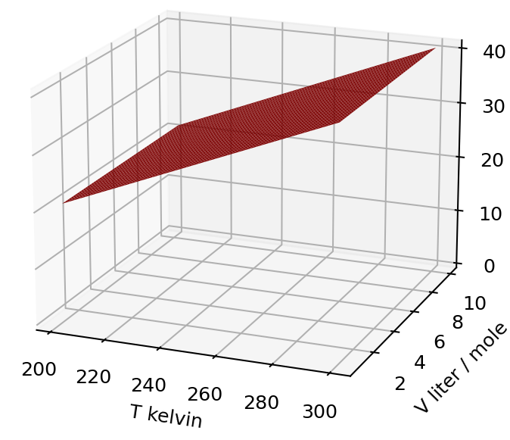
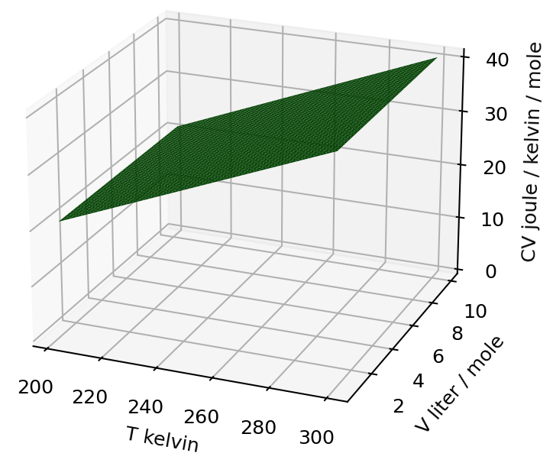


Bottom line: if $C_{V}\left(T,V\right)$ is T-independent => it’s an atomic gas. Otherwise, it’s a polyatomic gas
$$U(T,V)$$
$$C_{V}(T,V)$$
Constant slope in the temperature direction
Increasing slope in the temperature direction

